Slide 1
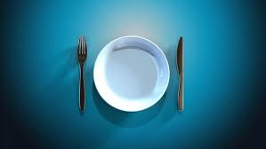
Biblical Fasting – What, Why, and How
By Andy Acreman
Thurrock Christian Fellowship
Sunday 28th December 2025

Slide 2
What Is Biblical Fasting?
In the Bible, fasting is voluntarily abstaining from our usual food (and sometimes usual drink or other physical needs or our luxuries)…
…for a set period, not as self-punishment, but to focus intensely…
…on God for spiritual breakthrough, guidance, repentance, or to express deep humility, connecting with Him beyond physical our needs.

Slide 3
What we will cover today…
Why we should all fast – some quotations and examples from great Christian Leaders
Types of fasting to engage in – the three basic kinds
How to fast and when – some practical advice
When do we begin? – putting this into practice in TCF

Slide 4
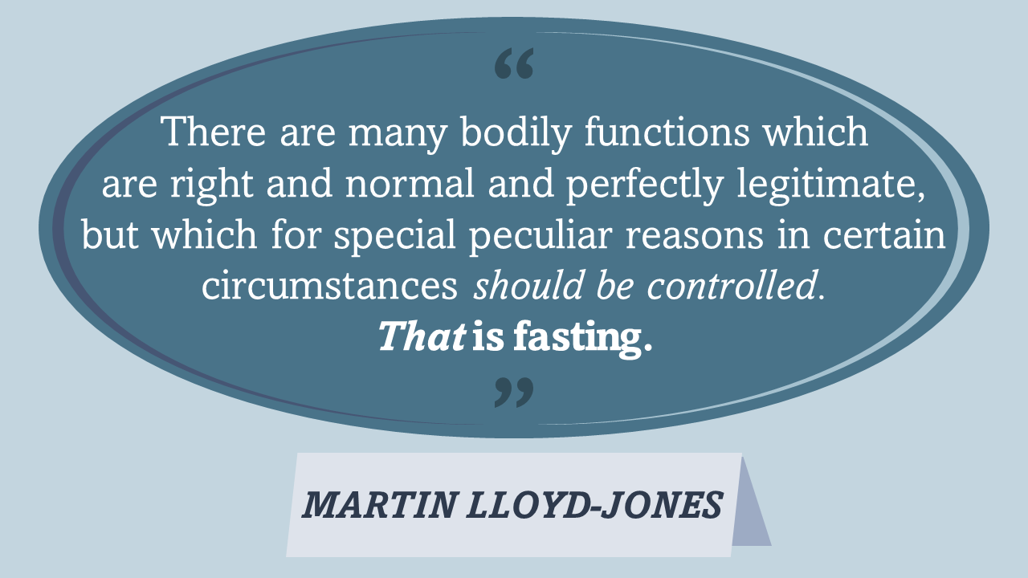
Why?

Slide 5
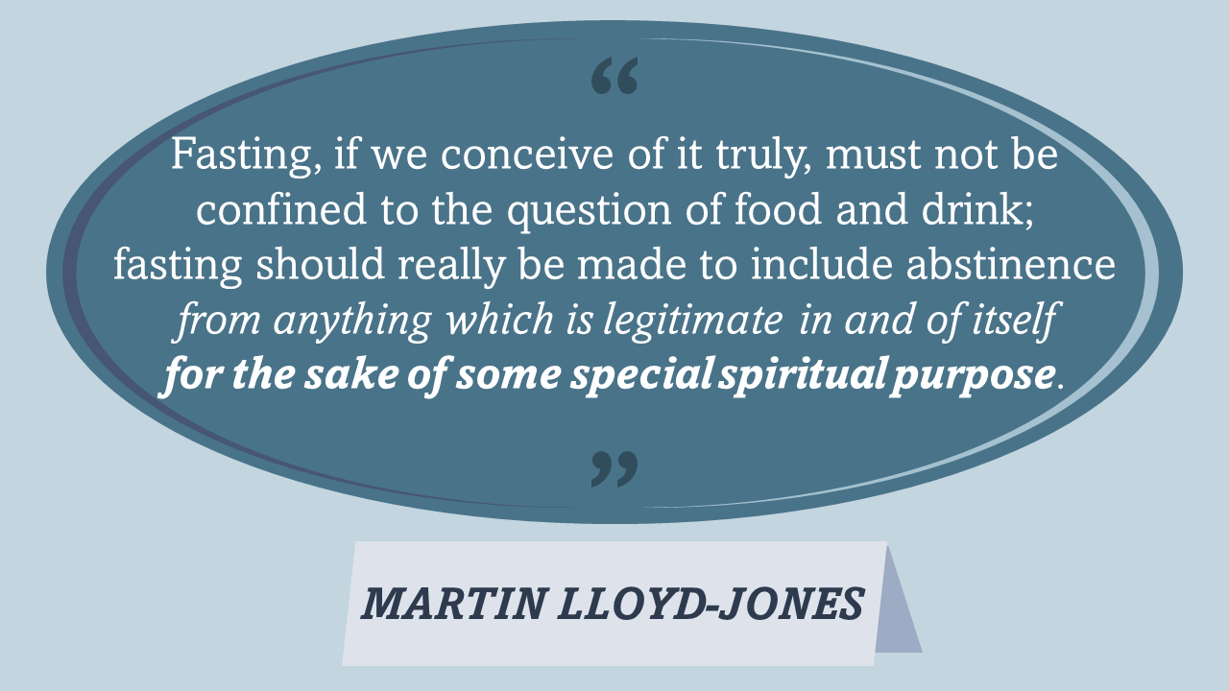
Why?

Slide 6
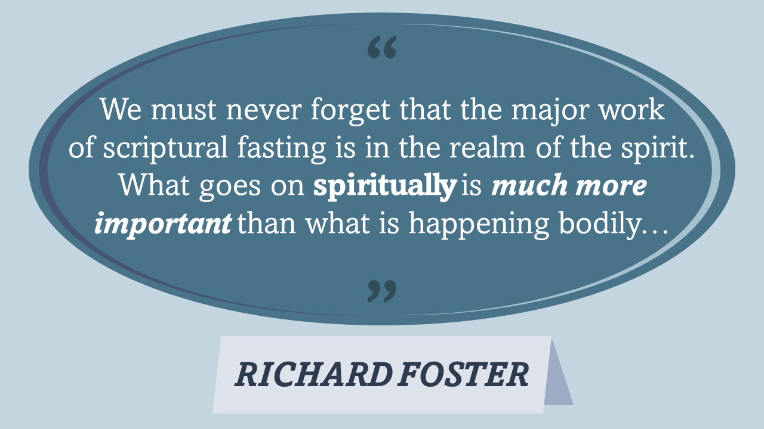
Why?
Notes:
So this is NOT primarily medical fasting or dietary fasting – even though “biblical fasting” does also have big medical and weight-loss benefits – but it is fasting that is primarily aimed at spiritual benefits!
When we fast, we must - from the outset – be clear WHY we are doing it. We must come into agreement with the Holy Spirit as to our goals.

Slide 7
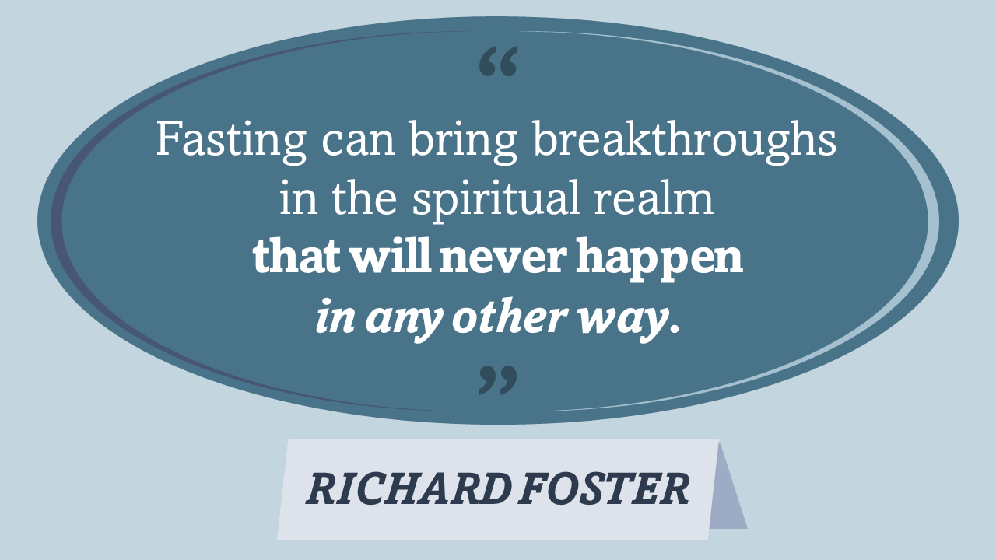
Why?
Notes:
To summarise so far: Fasting adds a turbo-boost to our waiting on God and to our prayers. It is living the spiritual life on steroids!

Slide 8
Types of Fasting?
The Normal Fast: no food at all, for a period of time
The Absolute Fast: no food or water/drink at all, for a period of time
The Partial Fast: restriction of diet &/or luxuries, for a continuous period of time or for set times of the day / night

Slide 9
1. The Normal Fast (1)…
Luke 4:1-2 NIV. Jesus, full of the Holy Spirit, left the Jordan and was led by the Spirit into the wilderness, where for forty days he was tempted by the devil. He ate nothing during those days, and at the end of them he was hungry.
Psalm 35:13 NIV. Yet when they were ill, I put on sackcloth and humbled myself with fasting…
Acts 13:2-3 NIV. While they were worshiping the Lord and fasting, the Holy Spirit said, “Set apart for me Barnabas and Saul for the work to which I have called them.” So after they had fasted and prayed, they placed their hands on them and sent them off.
Notes:
Jesus went on a very long fast of forty days and nights without eating anything. But he did drink. Not surprisingly at the end of that time he was ‘hungry’! (But not ‘thirsty’). Not all fasts need to be as long as this. A whole day and night is manageable for most of us. What is the Holy Spirit saying to us? Three days and nights is also a good period of time. Some can manage more than others – it’s more difficult if you have a demanding physical job.
Fasting is humbling ourselves before God. We need times of feasting and celebration, but also times when we withdraw and wait humbly for Him to speak to us.
The church regularly worshiped and fasted together. Notice that when they received revelation, they fasted some more to pray it.

Slide 10
1. The Normal Fast (2)…
Matthew 6:16-18 NIV. “When you fast, do not look sombre as the hypocrites do, for they disfigure their faces to show others they are fasting. Truly I tell you, they have received their reward in full. But when you fast, put oil on your head and wash your face, so that it will not be obvious to others that you are fasting, but only to your Father, who is unseen; and your Father, who sees what is done in secret, will reward you.
Ezra 8:21,23 NIV. There, by the Ahava Canal, I proclaimed a fast, so that we might humble ourselves before our God and ask him for a safe journey for us and our children, with all our possessions… So we fasted and petitioned our God about this, and he answered our prayer.
Notes:
“WHEN you fast” – not “IF” you fast! This is not an optional extra to the Christian life – it is part of it. This passage comes from the ‘Sermon On The Mount’ and also incudes the phrases: “When you pray” and “When you give”. Jesus expects us all to do all these things. If He is our Lord, then this is part of our obedience to Him.
Ezra was leading a group of Jewish exiles back to Jerusalem, with the king’s blessing and, despite it being a dangerous journey, did not want to ask the king for soldiers and horsemen to protect them, but wanted to trust God for their security. So before they set out, first they fasted and prayed. God answered their prayer!

Slide 11
2. The Absolute Fast…
Deuteronomy 9:9,18 NIV. When I [Moses] went up on the mountain to receive the tablets of stone, the tablets of the covenant that the LORD had made with you, I stayed on the mountain forty days and forty nights; I ate no bread and drank no water… Then once again I fell prostrate before the LORD for forty days and forty nights; I ate no bread and drank no water, because of all the sin you had committed, doing what was evil in the LORD’s sight and so arousing his anger.
Acts 9:8-9 NIV. Saul got up from the ground, but when he opened his eyes he could see nothing. So they led him by the hand into Damascus. For three days he was blind, and did not eat or drink anything.
Notes:
When Moses first went up Mount Horeb to receive the Law, he fasted from EVERYTHING for 40 days and nights. A medical impossibility – 3 days without water is the maximum – and so God did a miracle in Moses’ body. Then, after the Golden Calf incident, Moses went up the mountain again to pray for Israel, and to get more stone tablets. He again fasted for 40 days and nights, making a total of 80 days and nights!
Saul – after first meeting Jesus in his vision – fasted three days and three nights without food OR water. The human limit! Don’t try this yourselves, and don’t start off with some impossible fasting regime!
Muslims who fast during Ramadan avoid both food and water, but only during daylight hours.

Slide 12
3. The Partial Fast…
Daniel 10:1-6,12-14 NIV. In the third year of Cyrus king of Persia, a revelation was given to Daniel… Its message was true and it concerned a great war. The understanding of the message came to him in a vision. At that time I, Daniel, mourned for three weeks. I ate no choice food; no meat or wine touched my lips; and I used no lotions at all until the three weeks were over.
On the twenty-fourth day of the first month, as I was standing on the bank of the great river, the Tigris, I looked up and there before me was a man dressed in linen, with a belt of fine gold from Uphaz around his waist. His body was like topaz, his face like lightning, his eyes like flaming torches, his arms and legs like the gleam of burnished bronze, and his voice like the sound of a multitude…
[12] Then he continued, “Do not be afraid, Daniel. Since the first day that you set your mind to gain understanding and to humble yourself before your God, your words were heard, and I have come in response to them. But the prince of the Persian kingdom resisted me twenty-one days. Then Michael, one of the chief princes, came to help me, because I was detained there with the king of Persia. Now I have come to explain to you what will happen to your people in the future, for the vision concerns a time yet to come.”
Notes:
Daniel decided to seek the Lord from his home in Babylon, centre of the new Persian empire under King Cyrus. So he did a ‘Partial Fast’ (what I call a ‘Daniel Fast’) for 3 weeks, still eating and drinking, but restricting himself to basic vegetarian foods and probably just water. He used no luxury products either, even though, as Deputy Prime Minister, he was used to a wealthy lifestyle.
The main benefit was that it was able to last a longer time than the usual ‘Normal Fast’ or ‘Absolute Fast’. Notice it was also described as ‘Mourning’! We should not feel ‘good’ about fasting, but slightly ‘bereaved’.
It brought a heavenly messenger to Daniel with revelation from God. It also enabled him to participate effectively in heavenly battles.

Slide 13
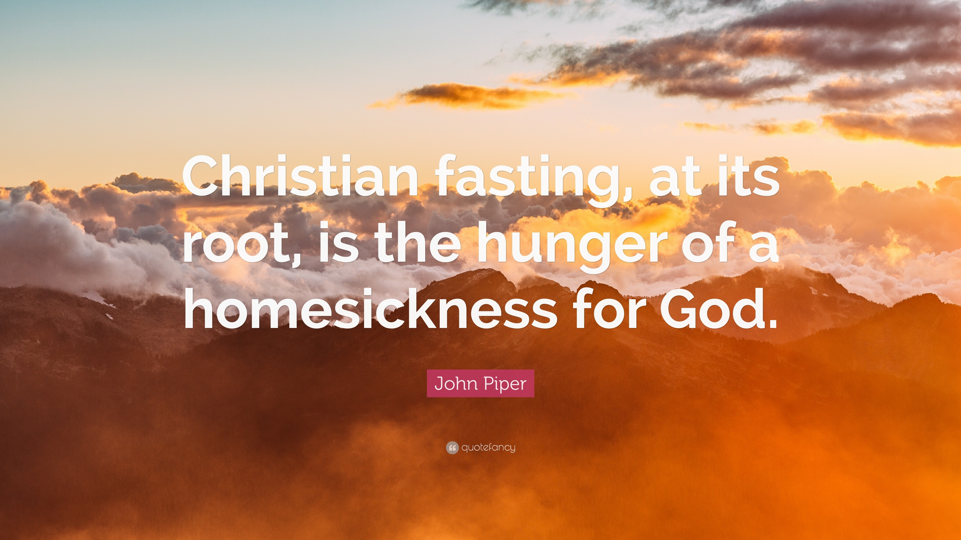
Why?

Slide 14
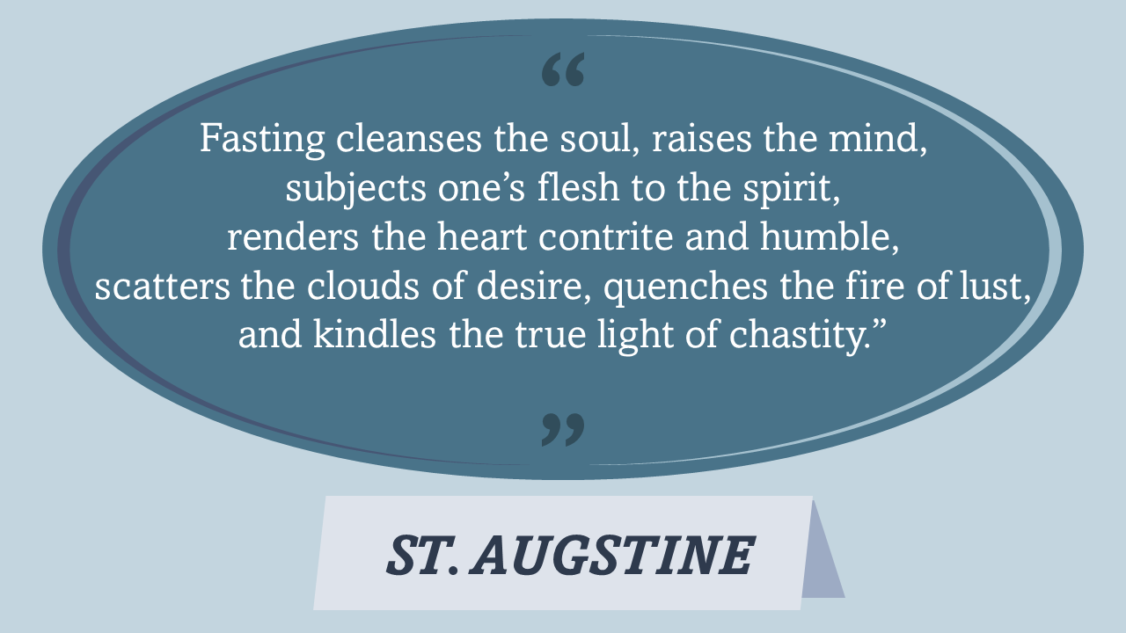
Why?

Slide 15
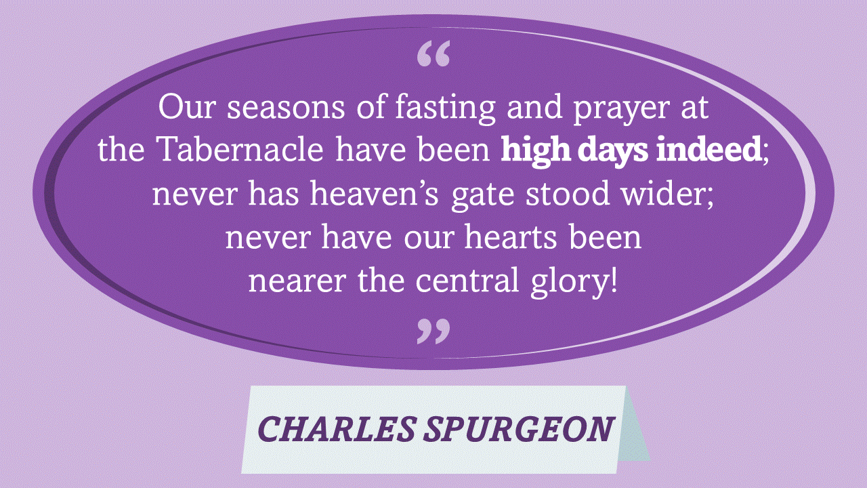
Why?

Slide 16
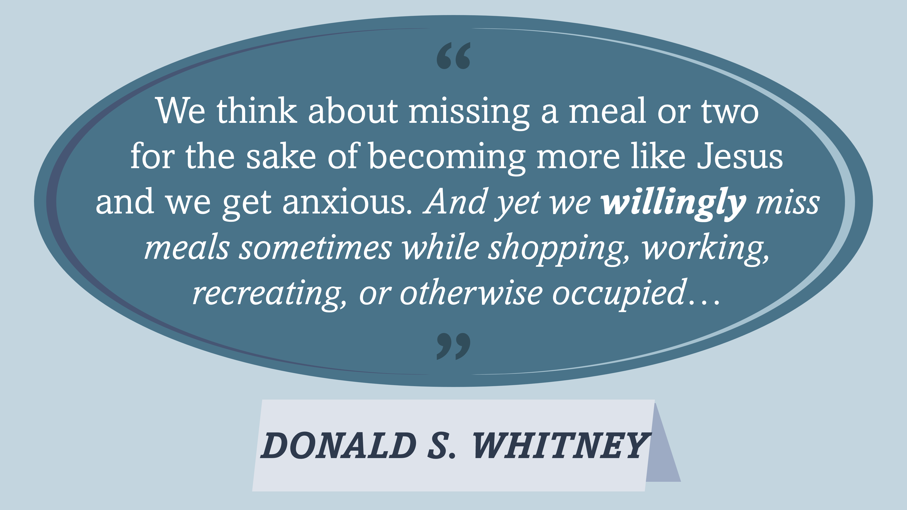
Why?

Slide 17
How and When to Fast
Fast regularly, fast when God tells you, fast to get breakthroughs
Consult your doctor before fasting for the first time
One day per week is a good target – to boost your prayer life
Decide whether or not to avoid caffeine drinks (headaches)
Plan it and let your family know – to manage expectations
Don’t get legalistic and don’t fall under condemnation
A whole day is probably easier than parts of a day
Ending a long fast takes some careful dietary management
We should also fast together as a church. It’s powerful!
Notes:
If you are on certain medications, then be cautious. Consult your doctor. Perhaps a ‘Daniel Fast’ is the safest one for you?
If you ‘slip up’, don’t get condemned, but resume the fast and carry on. God is fine with that!
Ask the Holy Spirit - but have a plan! Don’t think about food during the day but think about God. Seek Him and keep busy!
Be careful what you break your longer fasts with. Your digestive system needs to get used to food again!

Slide 18
Corporate Fasting
Leviticus 23:27 NIV. “The tenth day of this seventh month is the Day of Atonement. Hold a sacred assembly and deny yourselves and present a food offering to the LORD.
Joel 2:13,15-16 NIV. Rend your heart and not your garments. Return to the LORD your God, for he is gracious and compassionate, slow to anger and abounding in love, and he relents from sending calamity… [15] Blow the trumpet in Zion, declare a holy fast, call a sacred assembly. Gather the people, consecrate the assembly; bring together the elders, gather the children, those nursing at the breast. Let the bridegroom leave his room and the bride her chamber…
Notes:
The Day of Atonement was the holiest day of the Old Testament calendar. The only one in which a yearly national fast was expected.
The Joel time was during a period of national repentance, calling on God for grace and mercy on the nation. We should do this as a church too!

Slide 19
Motivation and Behaviour in Fasting
Isaiah 58:3-4,6-9,11-12 NIV
‘Why have we fasted,’ they say, ‘and you have not seen it? Why have we humbled ourselves, and you have not noticed?’ “Yet on the day of your fasting, you do as you please and exploit all your workers. Your fasting ends in quarrelling and strife, and in striking each other with wicked fists. You cannot fast as you do today and expect your voice to be heard on high…
[6] “Is not this the kind of fasting I have chosen: to loose the chains of injustice and untie the cords of the yoke, to set the oppressed free and break every yoke? Is it not to share your food with the hungry and to provide the poor wanderer with shelter—when you see the naked, to clothe them, and not to turn away from your own flesh and blood?
Notes:
The Jews were simply doing fasting as a virtue-signalling exercise, and they were behaving badly whilst the fast was going on.
Many years later – as we read earlier in Matthew 6:16-18 - Jesus strongly rebuked the Pharisees for ‘fasting for show’ – deliberately looking haggard and unkempt – and said that they had already received their ‘reward’ in full. Whereas if we fast in secret, our Heavenly Father who sees this, will reward us. Secret fasting is an act of genuine faith!
The Isaiah passage continues… [next slide]

Slide 20
Motivation and Behaviour in Fasting
“Then your light will break forth like the dawn, and your healing will quickly appear; then your righteousness will go before you, and the glory of the LORD will be your rear guard. Then you will call, and the LORD will answer; you will cry for help, and he will say: ‘Here am I’. If you do away with the yoke of oppression, with the pointing finger and malicious talk… [then…]
[11] “The LORD will guide you always; he will satisfy your needs in a sun-scorched land and will strengthen your frame. You will be like a well-watered garden, like a spring whose waters never fail. Your people will rebuild the ancient ruins and will raise up the age-old foundations; you will be called Repairer of Broken Walls, Restorer of Streets with Dwellings”.
Notes:
So God is NOT saying that we should avoid fasting; He is simply saying that external actions on their own, without having the fruit of the Holy Spirit operating inside us, is hypocritical and a complete waste of time! Let’s fast with the right motivation, with faith, and with godly behaviour! Then the blessing comes from heaven!

Slide 21
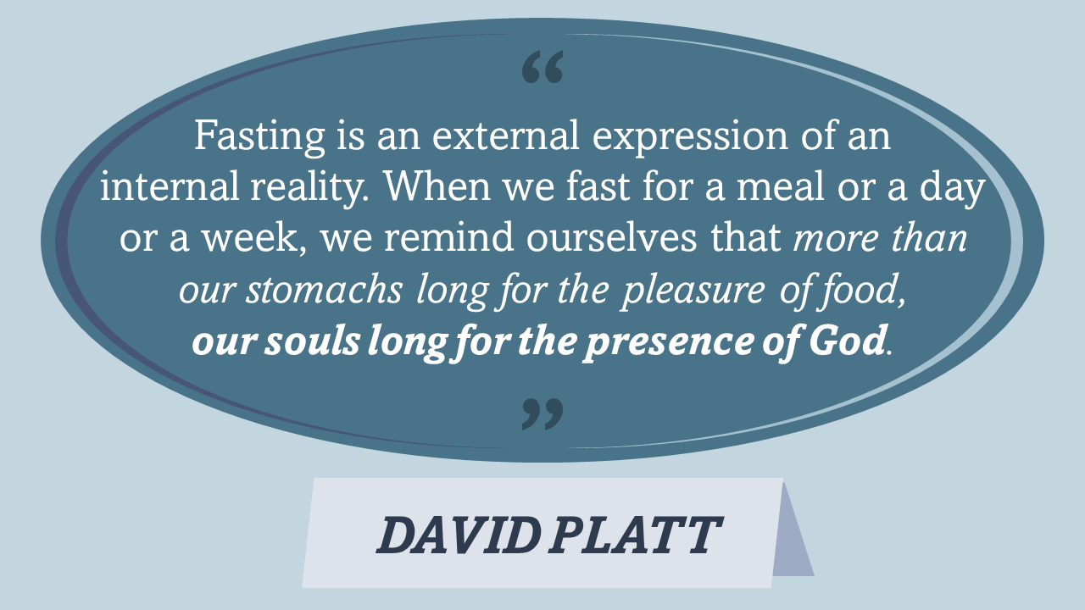
Why?

Slide 22
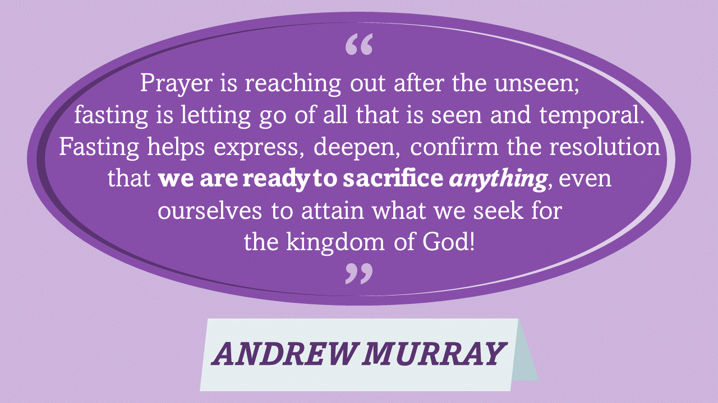
Why?

Slide 23
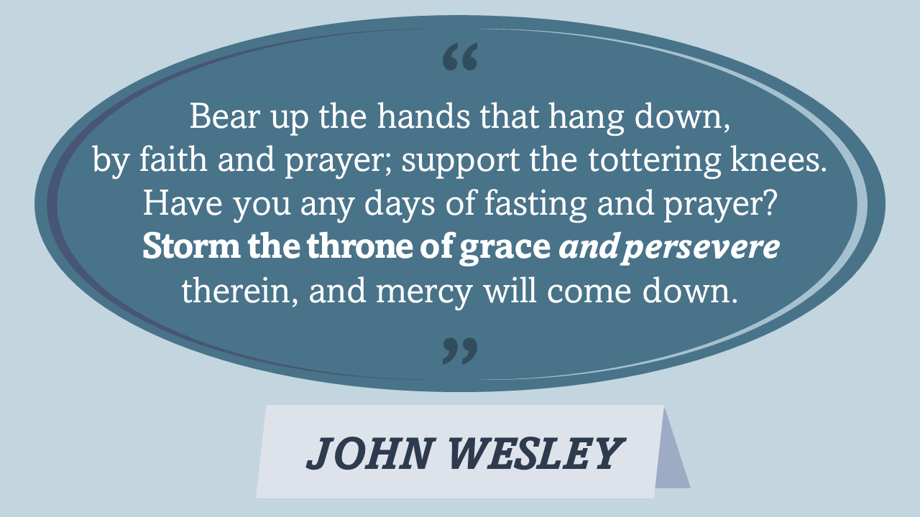
Why?

Slide 24
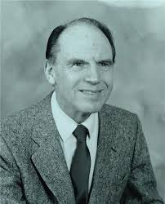
Why?
Fasting is calculated to bring a note of urgency and importance into our praying, and to give force to our pleading in the Court of Heaven. The man who prays with fasting is giving Heaven notice that he is truly in earnest!
(Arthur Wallis – “God’s Chosen Fast”, 1968)
Notes:
My final slide…
Arthur Wallis was the founder of the charismatic Christian movement in the UK. He once preached at TCF. He had a powerful ministry of healing and miracles. Fasting was one of his secrets!
Talk to God about this, but just do it! “Fast regularly; fast when God tells you to; fast to get breakthroughs”.
After Christmas – as a church family - we plan to have a period of ‘Daniel Fasting’ in January in order to seek God’s will for the coming year. Saturday 3rd to Friday 23rd (= 21 days). Let’s get ourselves ready for this time. It’ll be great! God bless you all.

